Slide 1
IST 736 TEXT MINING DRUG REVIEWS ANALYSIS
Professor: Bei Yu
By
Akshay Bhala
Sharvil Turbadkar
Yeswanth Reddy Velapalem

Slide 2
Data Description
The entire data set had around 161297 number of samples.
Each sample has the following fields:
Unique Id
Name of the Drug
Condition for which drug is used
Review by a user for this drug
Rating given by the user
Date on which drug was reviewed
useful Count which represents number of users who found the review useful.
885 Unique number of conditions and 3436 unique drugs.

Slide 3
Preprocessing
Missing values were dropped as they constitute only <1% of the data.
Approx. 900 observations were dropped as they had undesired input in the condition attribute.
All the reviews are then cleaned using regular expressions.
A new feature ‘sentiment’ was created with three categories ‘positive’, ‘neutral’, ‘negative’ based on rating feature.
Rating 1-4 -> negative
Rating 5-7 -> neutral
Rating 8-10 -> positive

Slide 4
Exploratory Analysis
Most common condition
Most popular drug
Conditions with most number of drugs in market

Slide 5
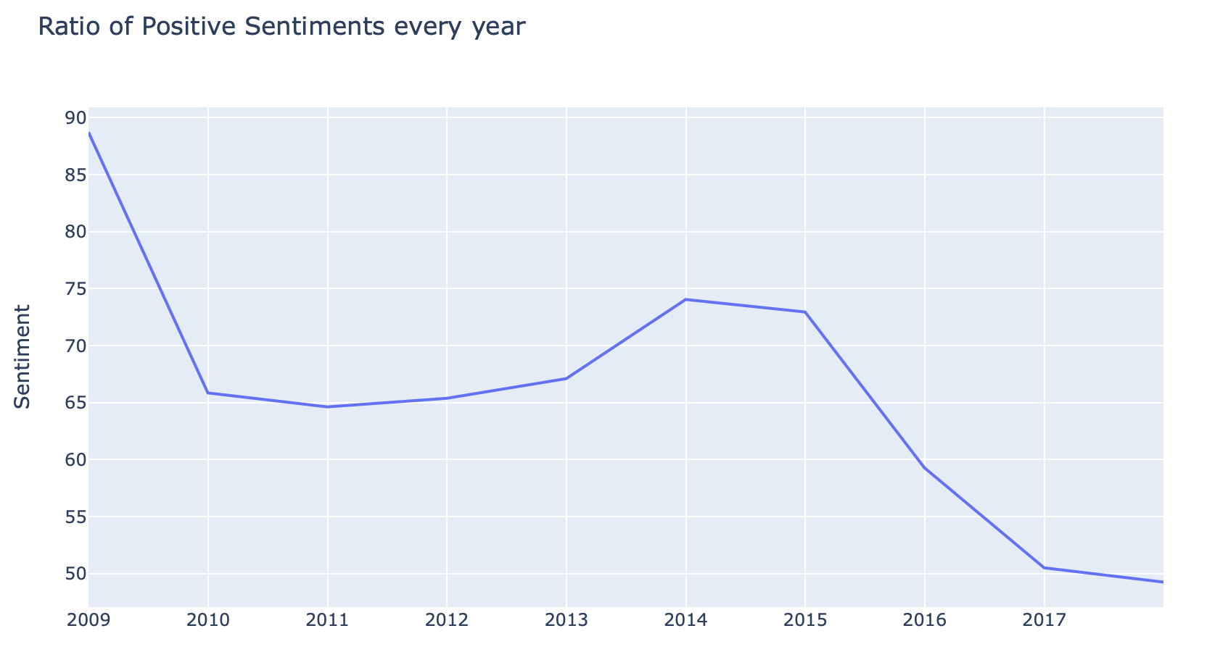
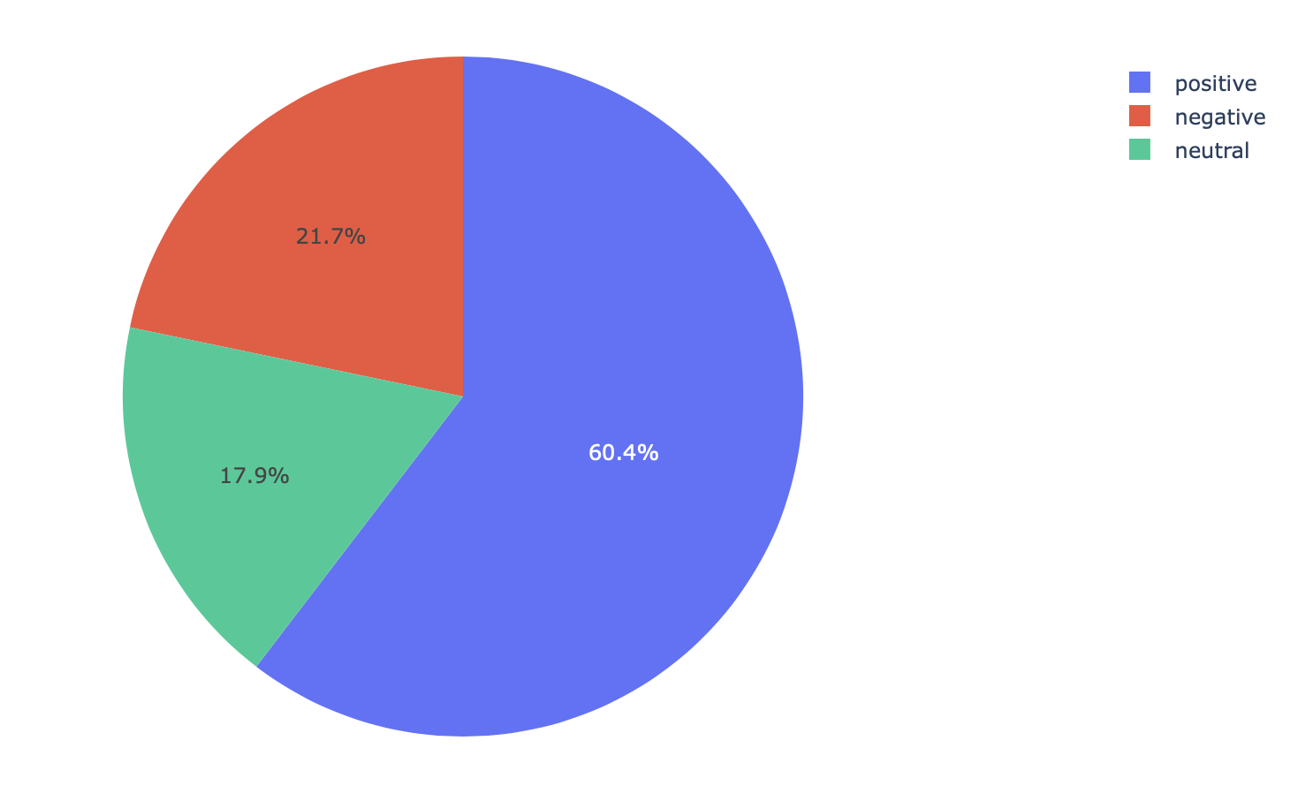
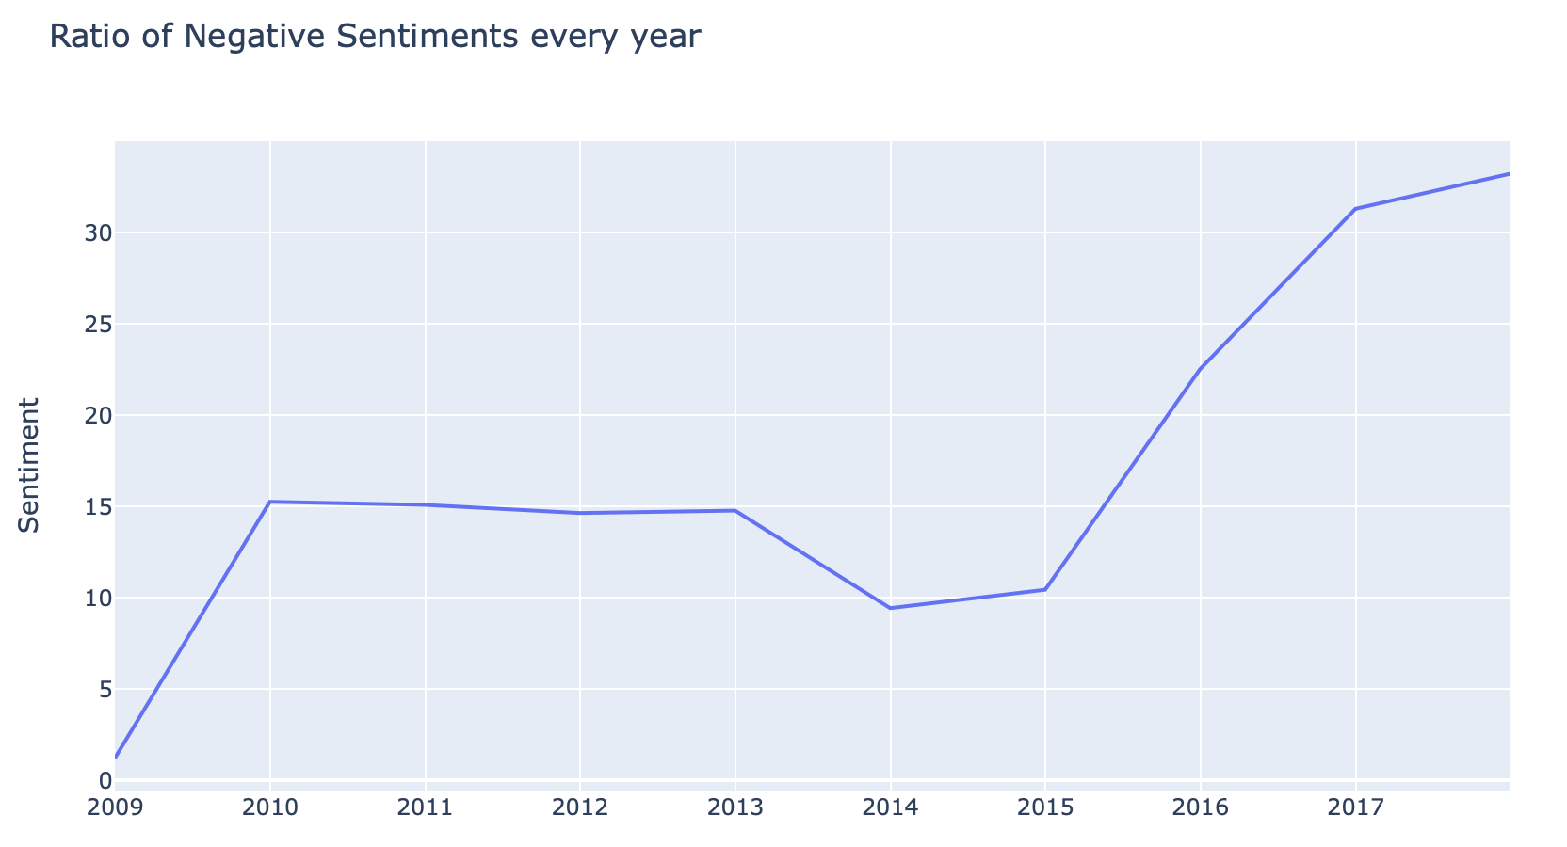
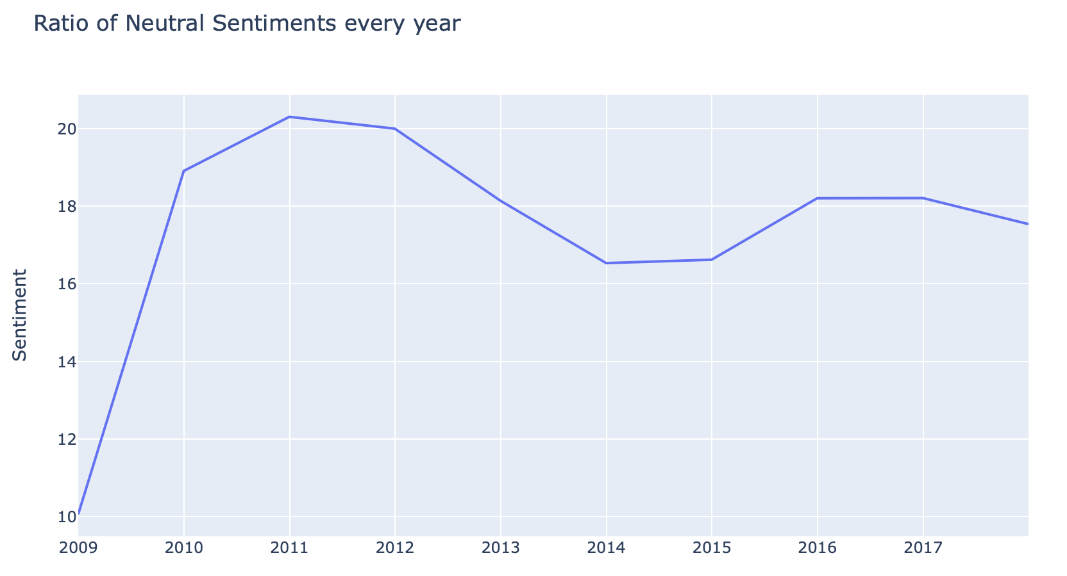
Sentiment Exploration

Slide 6
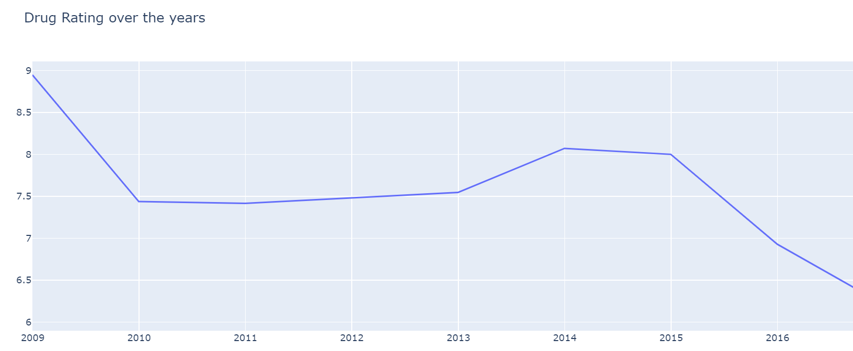
Drug Rating over Years

Slide 7
Task 1 : Predicting the condition
For this task, we filtered the data and extracted top 10 conditions along with the reviews.
Categories : 'ADHD’, 'Acne’, 'Anxiety’, 'Bipolar Disorder’, 'Birth Control’, 'Depression’, 'Insomnia’, 'Obesity’, 'Pain’, 'Weight Loss'
Stemmed the reviews without resulting any loss in information.
Both Hold-out test and cross validation were performed. We used 70% of the data for training and 30% for testing.
The target variable ’condition’ was little imbalanced as one category constituted for 30% of the variable whereas the others were 3-9% each.

Slide 8
Modeling
The algorithms used were Naïve Bayes (Multinomial and Bernoulli) and Linear Support Vector Machine.
Used Count Vectorizer with stop words removed, n-grams, [a-z]+ token pattern.
10-fold cross validation was implemented to compare the performances against hold-out method.

Slide 9
Performance of the best models
 | Recall | Precision | F1 score | Hold-out score | 10-fold cross validation score | Best Parameters
Multinomial Naïve Bayes | 79.84 | 78.22 | 78.94 | 84.30 | 84.25 | min_df=5, ngram_range=(1,1)
Bernoulli Naïve Bayes | 78.05 | 76.15 | 76.63 | 82.45 | 79.93 | min_df=5, ngram_range=(1,1)
Support Vector Machine | 75.60 | 74.53 | 75.0 | 81.59 | 81.76 | min_df=5, ngram_range=(1,2)

Slide 10
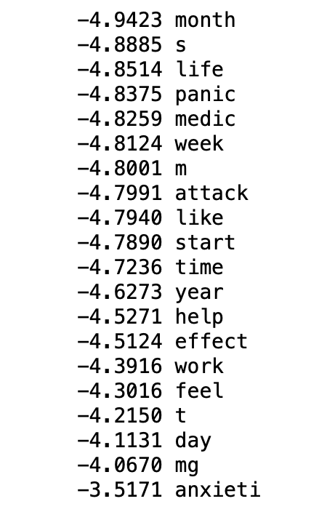
Most Important features Along with Precision, Recall, F1 score we can also look at important features learnt by the model which helps in improving model performance. These words are for the condition ‘Anxiety’.
Multinomial Naïve Bayes | Bernoulli Naïve Bayes | Support Vector Machine

Slide 11
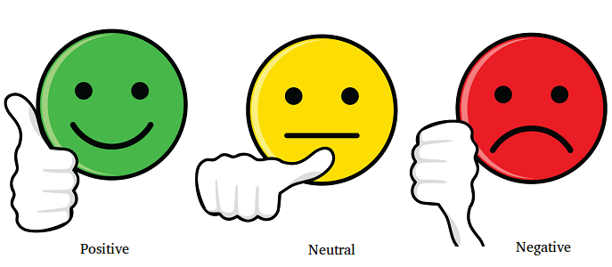
Task 2: Sentiment Analysis
With Sentiment analysis we mine patient reviews to identify and extract subjective information in patient reviews and help build a generalized understanding of how effective the drug performs .It understands the effectiveness and social sentiment associated with drug.

Slide 12
Sentiment Analysis
Our target variable is Sentiment. Our aim is to bifurcate patient ratings into their respective sentiments and then perform sentimental analysis to test how effective our classification algorithm has been. Data is heavily skewed as Positive sentiments take up 62% of the total sentiments.
Rating 1-4 -> negative
Rating 5-7 -> neutral
Rating 8-10 -> positive

Slide 13
Best Performing Model Parameters: (Trigrams , TF-IDF-Vectorizer , Slack Variable(C=5))
Performance of Linear-SVC
Sentiments | Positive | Neutral | Negative
Accuracy | 91.07% | 61.72% | 75.39%
Precision | 77.97% | 70.32% | 86.87%
Recall | 75.39% | 61.72% | 91.07%

Slide 14
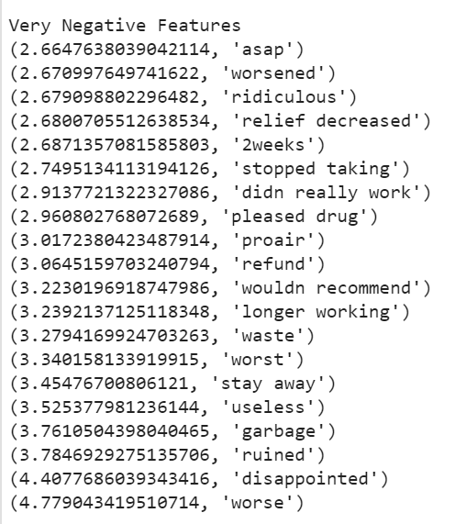
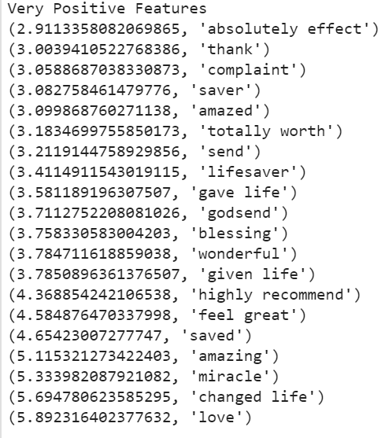
Most & Least Important Features
Very Negative Features
Very Positive Features

Slide 15
Error Analysis
Where reviews were negative, but prediction was positive(Examples)
nothing you can lose at all with this pills - only your money ,even with very strict diet(Advice , Sarcasm)
no relief worthless(Oxymoron)
it is December took pill in early August 2016(Sentences with no structure ,implicit meanings)
Linguistic Patterns(Advices , Sarcastic Comments ,Oxymorons)
Where reviews were positive, but prediction was negative(Examples)
"Zyprexa has given me my life back in 4 weeks! I have the worst panic attacks and chronic nausea ever!! I have been on every medication under the sun with no relief, if not worse nausea because of the side effects of all the medications. I was on Klonopin, propranolol, hydroxyzine, and zofran every single day and I was still having really bad nausea and panic attacks so bad, I could not leave my house. Dr. prescribed Zyprexa 5mg and after 3 days, I started eating again. I have already gained 2 lbs but I needed to because I was so nauseated I couldn&#039;t eat. I&#039;m so excited that I can eat again without feeling everything is going to come back up!!!! I hope it doesn&#039;t &quot;poop-out&quot; on me bc It&#039;s been a miracle!!“(Use of Very negative conditions followed by a positive conclusion)
The withdrawal symptoms I had were horrendous - it was like coming off narcotics. . Vomiting, shaking, muscle spasms, everything hurt. At one point drifting in and out of consciousness. But if I hadn&#039;t taken venlafaxine I probably wouldn&#039;t be here today. I would take it again if I had to. (Very negative side-effects followed by a positive conclusion)
Linguistic Patterns(Use of Oxymorons and adverse side effects or conditions followed by a brief positive conclusion )

Slide 16

This photo by Unknown Author is licensed under CC BY-NC
Thank you for your time . Please feel free to ask questions

